Slide 1

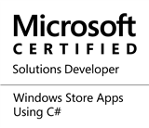


Microsoft Power Platform
Kent Chan
Feva Works IT Education Centre

Slide 2

What have you made with Microsoft Power Platform?

Slide 3

What is Microsoft Power Platform?
Power Apps
Model-driven apps
Canvas apps
Portal apps
Power Automate
Power Virtual Agents
Microsoft Power BI
Microsoft Dataverse

Slide 4
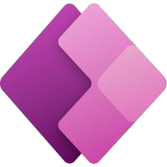


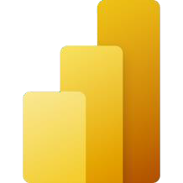

Powerful alone. Even better together.
Power Apps
Automate apps and drive business processes.
Embed Power Apps into dashboards and add Power BI tiles to apps.
Power Automate
Power BI
Dataverse
Drive actions to apps and services from chatbot conversations.
Analyze chatbot activity to refine and expand conversations.
Power Virtual Agent

Slide 5

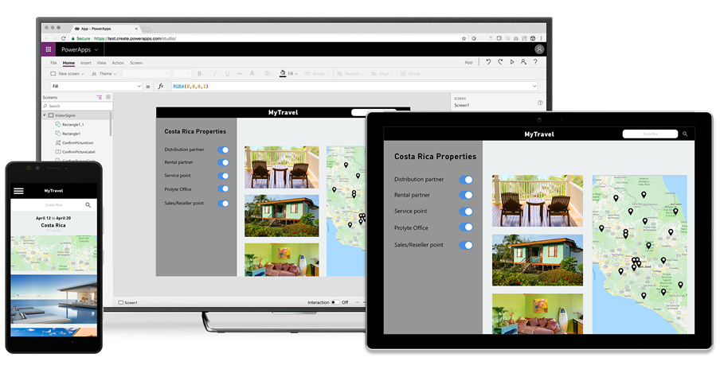
Build and consume solutions for web and mobile with Power Apps
Build highly customized task- and role-based canvas apps with data from one or multiple sources
Generate immersive model-driven apps, starting from your data model and business processes
Consume fully accessible apps across web and mobile, embedded or standalone, on any device

Slide 6
Power Apps building blocks
Power Apps is a collection of services, apps, and connectors that work together to let you do much more than just view your data.
Power Apps Home Page - Apps start here, whether you build them from data, a sample app, or a blank screen.
Power Apps Studio - Develop your apps further by connecting to data, adding and arranging user interface (UI) elements (known as controls), and building formulas.
Power Apps Mobile - Run your apps on Microsoft Windows, Apple iOS, and Google Android devices.
Power Apps Admin Center - Manage Power Apps environments and other components.

Slide 7
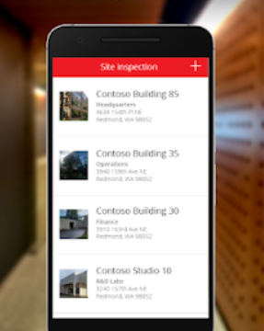
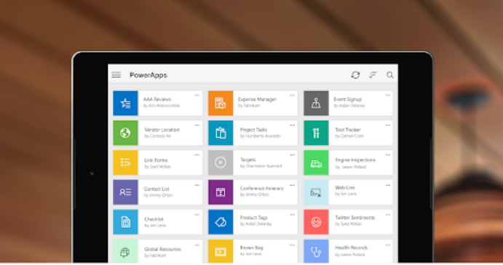
Power Apps Mobile
Power Apps Mobile for Windows, iOS, and Android devices allow you to use all the apps that you've created, and those others have shared with you, on your mobile device.

Slide 8
Types of Power Apps
Canvas apps
Start with user experience
WYSIWYG designer
Task-based & role-based apps
Mash-up data from hundreds of sources
Model-driven apps
Built on Dataverse
Start with a data model, relationships, and business processes
Build end-to-end business applications
Portals apps
Built on Dataverse
Engage with external stakeholders
Enable makers to build responsive websites
Improve and manage content with no code required

Slide 9
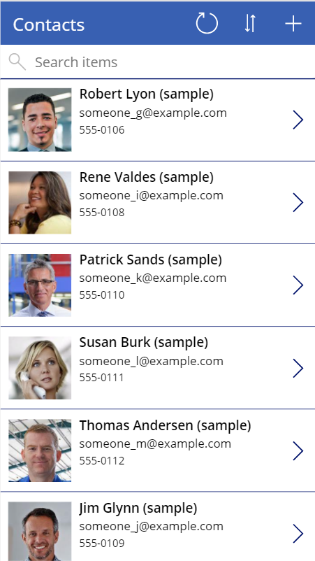
Canvas apps
Targets internal facing users
Designed around the user experience
Connect to hundreds of data sources
Automation
Built-in support for Microsoft Dataverse
Customizable with or without professional developers

Slide 10
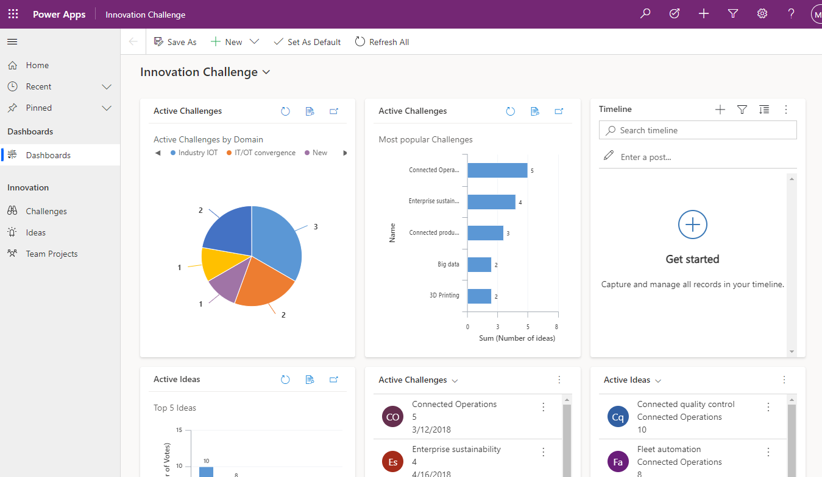
Model-driven apps
Targets internal facing users
Designed around the data
Powered by Microsoft Dataverse
Automation
Customizable and consistent user experience
Customizable with or without professional developers

Slide 11
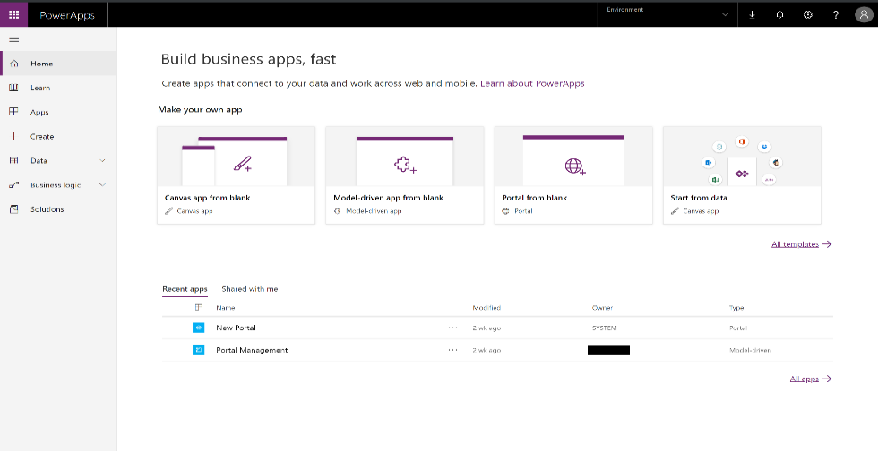
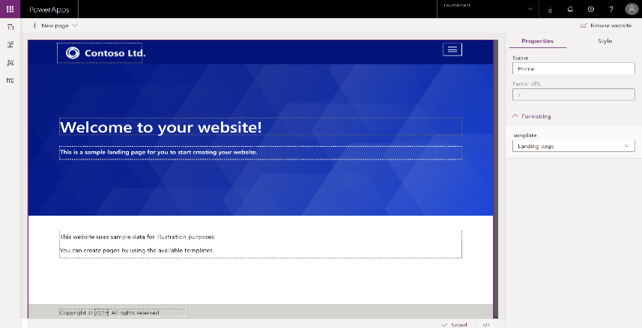
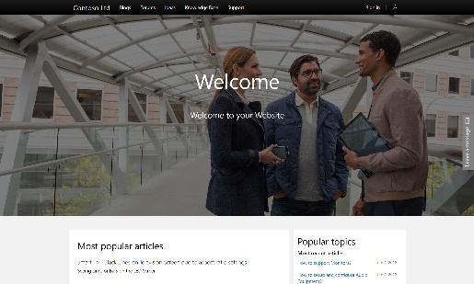
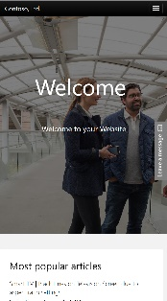
Power Apps Portals
Targets external stakeholders
Public-facing website
Powered by Dataverse
Customizable with or without professional developers

Slide 12

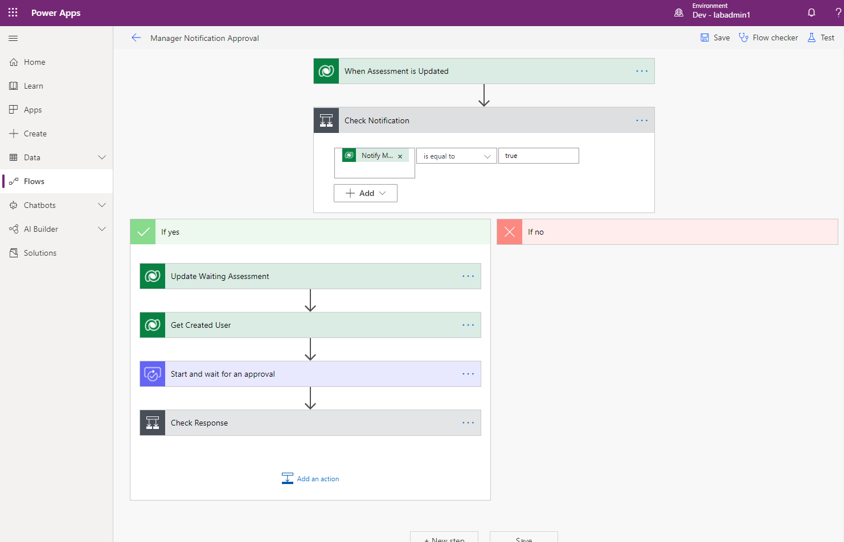
Automate and integrate business processes with Power Automate
Automate and model business processes across your apps and services
From simple automations to advanced scenarios with branches, loops, and more
Trigger actions, grant approvals, and get notifications right where you work
Automate legacy, on-prem and cloud-based applications and services

Slide 13





Types of Power Automate flows
Automated flows
Instant flows
Scheduled flows
Business process flows
Desktop flows
Cloud flows

Slide 14
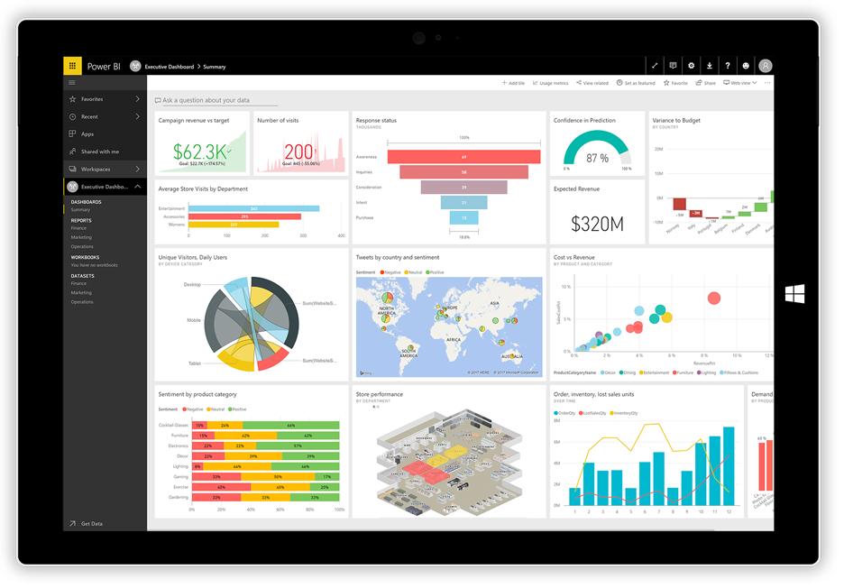
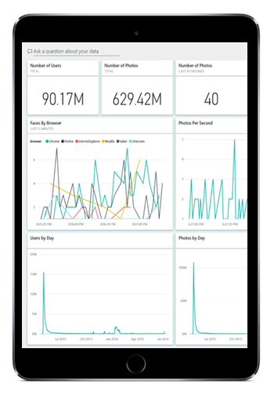
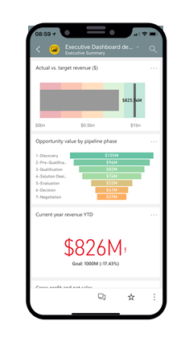
Gain insights from your data regardless of where it lives with Power BI
Connect to all your data and get a consolidated view across your business through a single pane of glass
Create ad-hoc analysis, live dashboards and interactive reports that are easy to consume on the web and across mobile devices
Build smart apps by infusing insights from your data and drive action with the power of Microsoft Power Platform

Slide 15

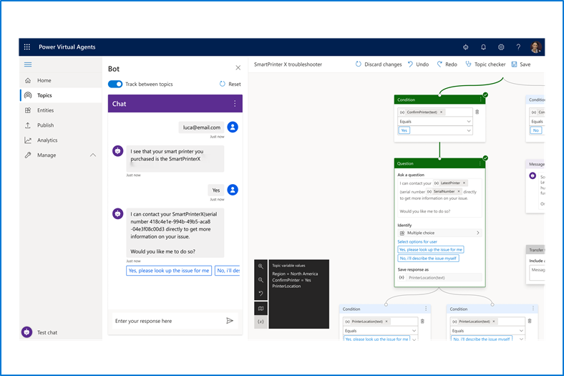
Build powerful virtual agents with Power Virtual Agents
Enable subject matter experts to easily create powerful virtual agents using a guided, no-code graphical interface—all without the need for data scientists or developers
Enable the virtual agent to take action on the customer’s behalf. Easily integrate your virtual agent with hundreds of services and systems out of the box or create custom workflows
Keep an eye on how your virtual agent is performing by using conversational metrics and dashboards. Get in-depth AI-driven insights to improve bot performance

Slide 16

Microsoft Dataverse
Microsoft Dataverse (formerly Common Data Service): Cloud-scale database used to securely store and manage data for Business Applications
Common Data Model: Definition of standard tables that represent commonly used concepts and activities

Slide 17
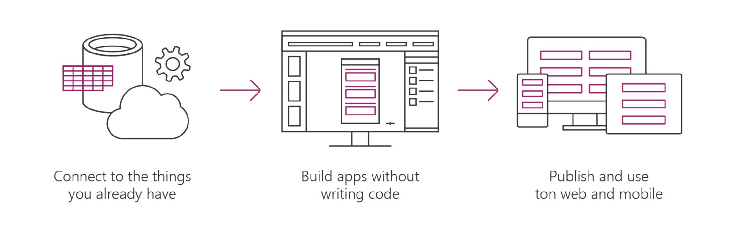

Dataverse
Allows you to securely store and manage the data used in apps
Dataverse is how Power Apps, Office, and the Dynamics suite of products integrate with a single system of record for business data
Store data in standard and custom tables with rich metadata
Build Power Apps apps and automate workflows against the data stored in Dataverse
Add business rules & validation Define role-based security

Slide 18
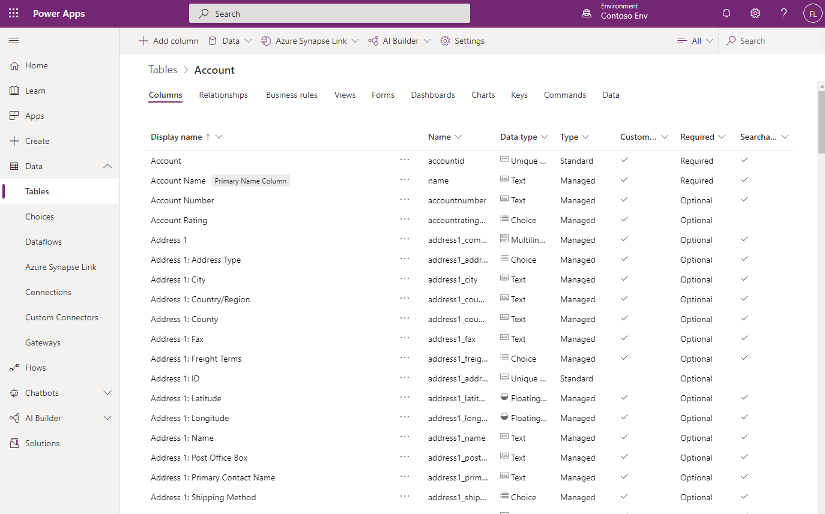
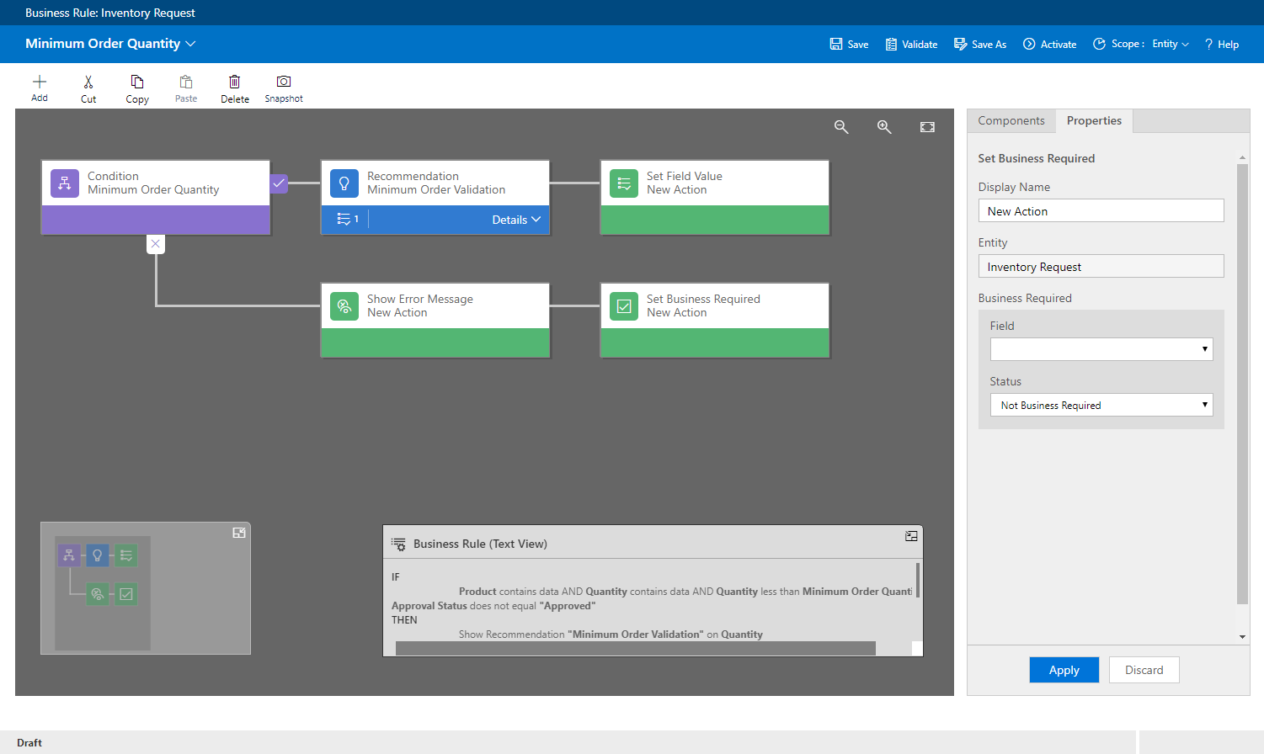
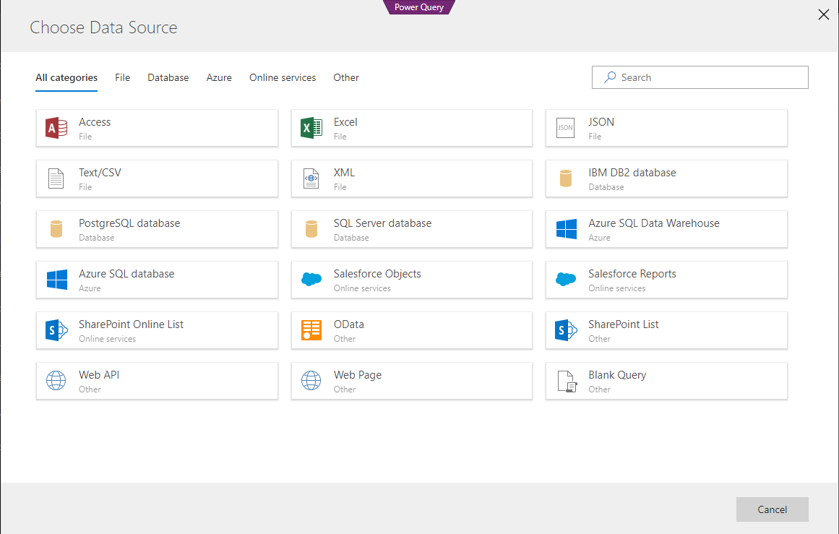
Dataverse
Standard tables that represent commonly used concepts and activities across a variety of business & app domains
Ability to extend the standard tables by adding custom columns and relationships
Add custom tables to support your scenario and application
Create calculated and roll up fields to provide consistent calculations across apps
Define business rules and validation to ensure data quality
Easily import and synchronize your data using Power Query
Sophisticated security model providing row level security and even models hierarchies.
Production ready pro developers use APIs allowing Dataverse access from any pro-dev application

Slide 19
Microsoft Dataverse
Simple to manage - Both the metadata and data are stored in the cloud. You don't need to worry about the details of how they're stored.
Helps to secure data - Data is stored so that users can see it only if you grant them access. Role-based security allows you to control access to tables for different users within your organization.
Access your Dynamics 365 Data - Data from your Dynamics 365 applications is also stored within the Dataverse, which allows you to quickly build apps that use your Dynamics 365 data and extend your apps by using Power Apps.
Rich metadata - Data types and relationships are used directly within Power Apps.
Logic and validation - Define calculated columns, business rules, workflows, and business process flows to ensure data quality and drive business processes.
Productivity tools - Tables are available within the add-ins for Microsoft Excel to increase productivity and ensure data accessibility.

Slide 20

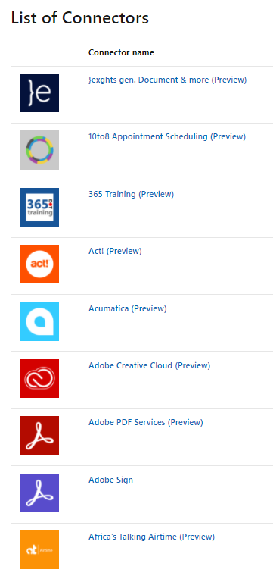

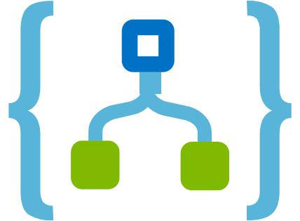
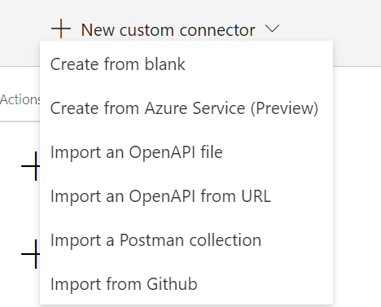
Data connectors
Connectors are available for use in multiple products
Power Automate
Power Apps
Logic Apps
Custom connectors:
An advantage of building custom connectors is that they can be used in different platforms, such as Power Apps, Power Automate, and Azure Logic Apps
It allow you to extend your app by calling a publicly available API, or a custom API you're hosting in a cloud provider, such as Azure
You can create custom connectors using different approaches

Slide 21

AI Builder
Analyze text for classification, key phrases, language, and sentiment.
Predict whether something will happen.
Process business card information.
Process text from images.
Read and save information from standard documents.
Recognize and count items in images.
And then use these results in apps and automation

Slide 22
Solutions
Solutions are containers of Power Platform components
Transport these customizations from one environment to another
Part of an overall strategy for application lifecycle management (ALM)
Much more later on
Development
Test
Production

